Slide 1
CHAPTER Externalities and
19 Public Goods

Slide 2
Defining Externalities
An externality
  Occurs whenever the activities of one economic agent
  Affect the activities of another economic agent in ways that are not reflected in market transactions
    Toxic chemical discharges
    Noise from airplanes
    Litter

Slide 3
Externalities in Production
Two firms
  One producing good x and the other producing good y
  The production of x will have an external effect on the production of y
    If the output of y depends not only on the level of inputs chosen by the firm but on the level at which x is produced
y = f(k, l; x)

Slide 4
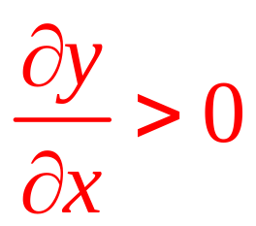
Beneficial Externalities
The relationship between the two firms can be beneficial
  Two firms, one producing honey and the other producing apples

Slide 5
Externalities in Consumption
Externalities
  Can also occur if the activities of an economic agent directly affect an individual’s utility
  Externalities can decrease or increase utility
Person A’s utility = U^{A}(x₁,…,x_{n};U^{B})
  Depends on the utility of another (B’s)
    Where x₁, …, x_{n} are goods consumed by A

Slide 6
Externalities in Consumption
Person A’s utility = U^{A}(x₁,…,x_{n};U^{B})
  If A is altruistic (wants B to be well off), ∂U^{A}/∂U^{B} > 0
  If A is envious of B, ∂U^{A}/∂U^{B} < 0
  If A is indifferent to B’s welfare, ∂U^{A}/∂U^{B} = 0

Slide 7
Externalities from Public Goods
Public goods are nonexclusive
  Once they are produced, they provide benefits to an entire group
  It is impossible to restrict these benefits to the specific groups of individuals who pay for them

Slide 8
Externalities and Allocative Inefficiency
Externalities
  Lead to inefficient allocations of resources
    Market prices do not accurately reflect the additional costs or benefits to third parties
One individual’s utility function utility = U(x,y)
  x and y are quantities of x and y consumed
  Has labor l = l_{x} + l_{y}
    l_{x} is labor allocated to the production of good x
    l_{y} is labor allocated to the production of good y

Slide 9
Externalities and Allocative Inefficiency
Production function for good x: x = f(l_{x})
The output of good y depends on:
  Amount of labor used and
  Amount of x produced
Production function for good y: y = g(l_{y}, x)
      g_{l} > 0: more labor produces more y output
      Negative externality: g_{x} < 0
      Positive externality: g_{x} < 0

Slide 10
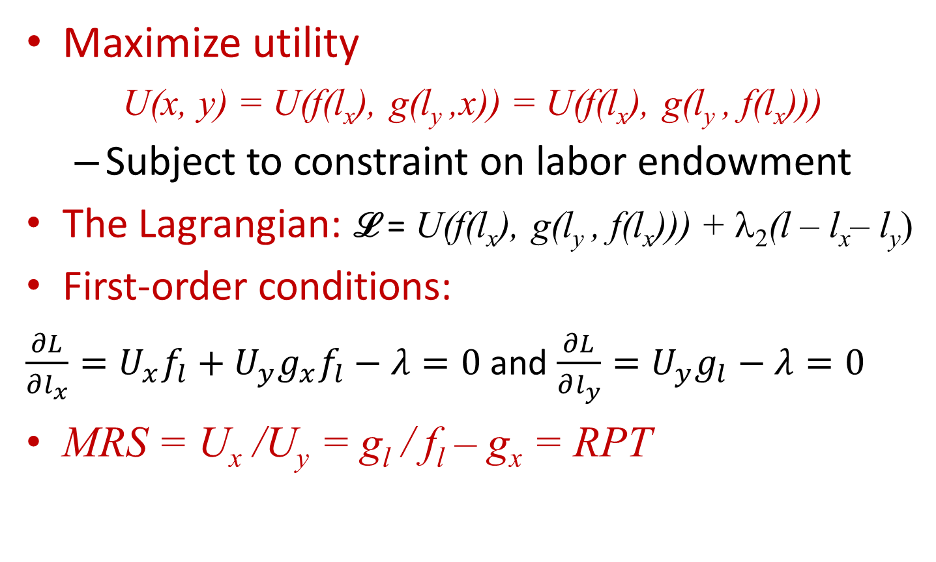
Finding the Efficient Allocation
Maximize utility
U(x, y) = U(f(l_{x}), g(l_{y} ,x)) = U(f(l_{x}), g(l_{y} , f(l_{x})))
  Subject to constraint on labor endowment
The Lagrangian: ℒ = U(f(l_{x}), g(l_{y} , f(l_{x}))) + λ₂(l – l_{x}– l_{y})
First-order conditions:
$\frac{∂L}{∂l_{x}}=U_{x}f_{l}+U_{y}g_{x}f_{l}−λ=0$ and $\frac{∂L}{∂l_{y}}=U_{y}g_{l}−λ=0$
MRS = U_{x} /U_{y} = g_{l} / f_{l} – g_{x} = RPT

Slide 11
Inefficiency of the Competitive Allocation
A utility-maximizing individual: MRS = p_{x}/p_{y}
The profit-maximizing producer of x
  Choose l_{x} such: p_{x}f_{l} = w (wage)
The profit-maximizing producer of y
  Choose l_{y} such: p_{y}g_{l} = w
Equilibrium condition for competitive pricing: MRS = g_{l} / f_{l}

Slide 12
Inefficiency of the Competitive Allocation
If x generates a negative externality
  Then g_{x} < 0: the competitive market leads to too much x compared to the social optimum
If x generates a positive externality
  Then g_{x} > 0: the competitive allocation involves too little x
If g_{x} = 0, no externality
  Competitive equilibrium is efficient

Slide 13
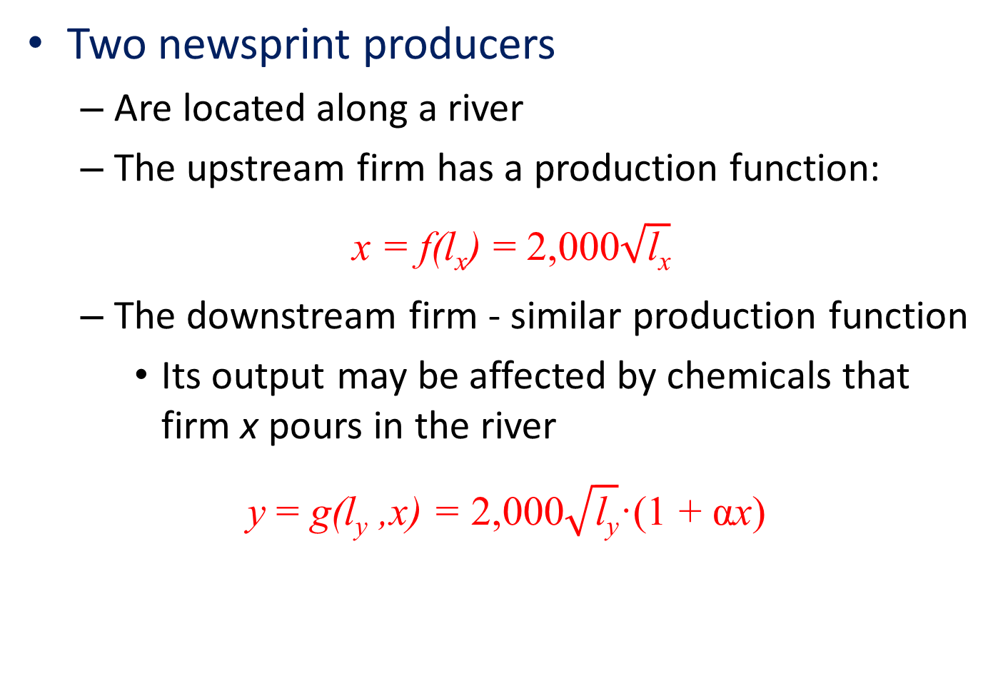
19.1 Production Externalities
Two newsprint producers
  Are located along a river
  The upstream firm has a production function:
x = f(l_{x}) = 2,000$\sqrt{\text{l}\text{x}}$
  The downstream firm - similar production function
    Its output may be affected by chemicals that firm x pours in the river
y = g(l_{y} ,x) = 2,000$\sqrt{\text{l}\text{y}}$·(1 + αx)

Slide 14
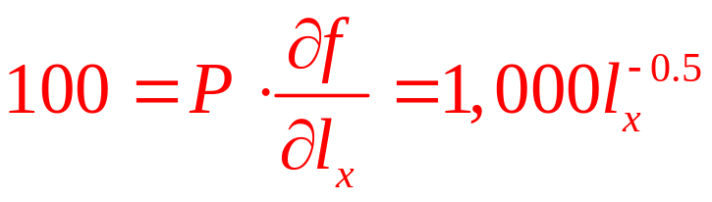
19.1 Production Externalities
Assume
  Newsprint sells for P = $1 per foot
  Workers earn w = $100 per day
Firm x will maximize profits
  Setting this wage equal to the labor’s marginal revenue product
  l_{x} = 100
  If α = 0 (no externalities), l_{y} = 100

Slide 15
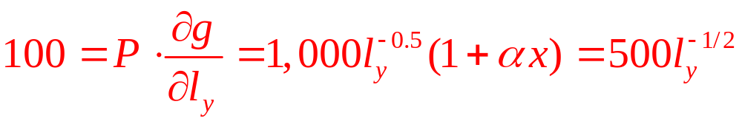
19.1 Production Externalities
Effects of a negative externality (α < 0)
  Its profit-maximizing decision will be unaffected
  (l_{x} = 100 and produces x = 20,000)
  But the marginal product of labor will be lower in firm y because of the externality
  If α = -1/40,000, firm y will maximize profits by
  Because of the externality, l_{y} = 25 workers and output is y = 5,000

Slide 16
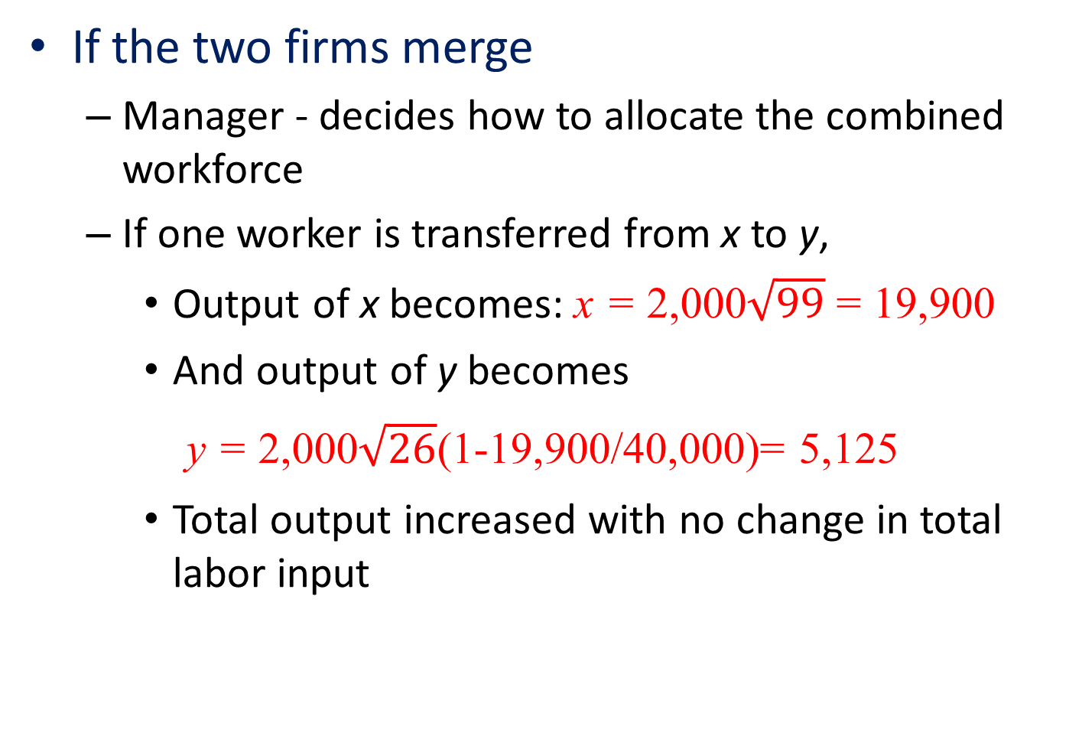
19.1 Production Externalities
If the two firms merge
  Manager - decides how to allocate the combined workforce
  If one worker is transferred from x to y,
    Output of x becomes: x = 2,000$\sqrt{99}$ = 19,900
    And output of y becomes
y = 2,000$\sqrt{26}$(1-19,900/40,000)= 5,125
    Total output increased with no change in total labor input

Slide 17
19.1 Production Externalities
Social marginal cost
  To produce x units, the firm needs to hire
  l_{x} = x² /4,000,000
  Total and marginal costs are:
  TC(x) = wl_{x} = x² /40,000
  MC(x) = TC’(x) = x /20,000
  The additional social cost is the harm done to the downstream firm
    Can be measured in monetary terms by the profits it loses when x is increased

Slide 18
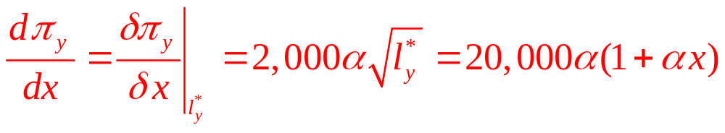
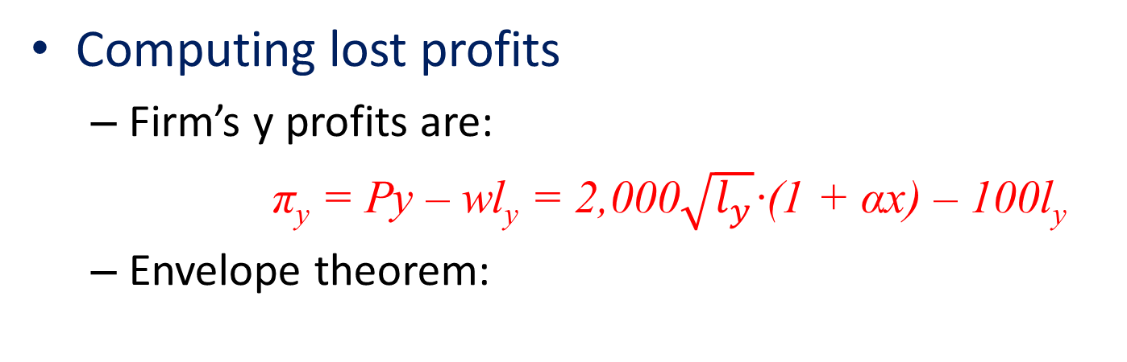
19.1 Production Externalities
Computing lost profits
  Firm’s y profits are:
  π_{y} = Py – wl_{y} = 2,000$\sqrt{l_{y}}$·(1 + αx) – 100l_{y}
  Envelope theorem:
  Gives the profit gain from an increase in x; the profit loss is the negative of this.

Slide 19
19.1 Production Externalities
Computing lost profits
  Combining the profit loss with the upstream firm’s private marginal cost gives the comprehensive social marginal cost:
SMC(x) = x/20,000 – 20,000α(1 + αx) = 3x/80,000 + 1/2
  Social marginal cost exceeds private marginal cost
    Leading the upstream firm to produce too much x in the competitive outcome

Slide 20
Partial-Equilibrium Model of Externalities
Supply-demand diagram
  Q = market quantity of the good that may have an associated externality
  Private marginal costs of production = MC(Q)
    Competitive supply curve for the good
  The (inverse) demand curve is P(Q)
  The competitive equilibrium: MC(Q) = P(Q), yielding the quantity Q_{c}

Slide 21
Partial-Equilibrium Model of Externalities
Negative externality
  Divergence between
    Private marginal costs MC(Q)
    And overall social marginal costs SMC(Q)
  Socially optimal output Q_{s} < Q_{c}
    And P_{s} reflects all costs (and P_{s} > P_{c})

Slide 22
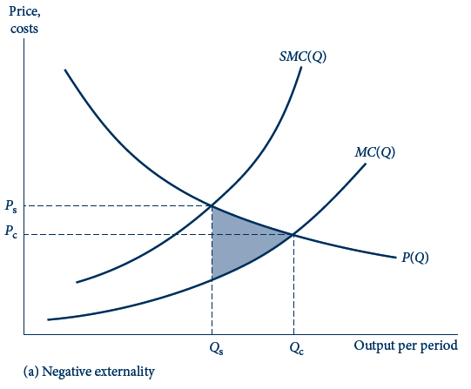
19.1 (a)Partial-Equilibrium Model of Externalities
The inverse demand curve for the good is given by P(Q) and private marginal costs by MC(Q), which is also the market supply curve.
Panel (a) illustrates the case of a negative externality in which the good imposes external costs on third parties. Social marginal costs SMC(Q) exceed MC(Q) by the extent of these costs; market equilibrium quantity Qc exceeds the socially efficient quantity Qs.
In both panels, deadweight loss from inefficient quantity given by area of shaded region.

Slide 23
Partial-Equilibrium Model of Externalities
Positive externality
  Divergence between
    Private marginal benefit P(Q)
    And overall social marginal benefit SMB(Q)
  Socially optimal output Q_{s} > Q_{c}
    And P_{s} reflects all benefits (and P_{s} > P_{c})

Slide 24
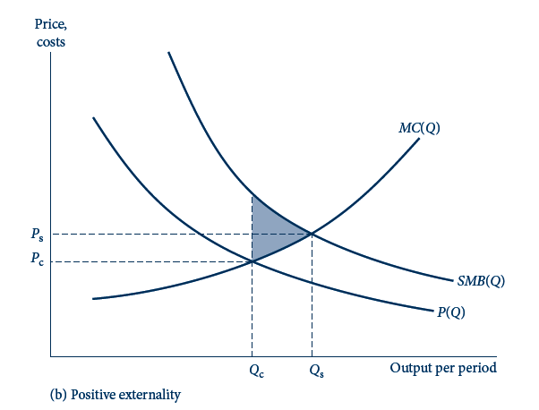
19.1 (b)Partial-Equilibrium Model of Externalities
The inverse demand curve for the good is given by P(Q) and private marginal costs by MC(Q), which is also the market supply curve.
Panel (b) illustrates the case of a positive externality in which the good benefits third parties. Social marginal benefits SMB(Q) lie above the inverse demand curve, implying Qc , Qs.
In both panels, deadweight loss from inefficient quantity given by area of shaded region.

Slide 25
Solutions to Negative Externality Problems
Incentive-based solutions to the harm from negative externalities
  Pigou: The most direct solution would be to tax the externality-creating entity
    All incentive-based solutions to the externality problem stem from this basic insight

Slide 26
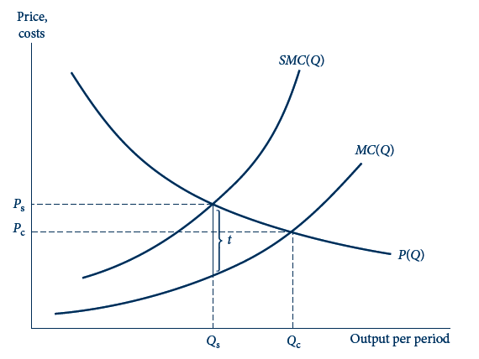
19.2 Pigovian Tax
This figure reproduces the panel from the previous figure illustrating a negative externality. A tax of amount t that reflects the social marginal costs above and beyond private marginal costs would achieve the socially efficient production level Qs.

Slide 27
Pigovian Tax
Imposition of a Pigovian tax, t
  Creates a vertical wedge between the demand P(Q) and supply MC(Q) curves for the good
  Reduce output from Q_{c} to Q_{s}
  The tax is set to reflect the distance between private marginal costs MC(Q) and social marginal costs SMC(Q)

Slide 28
19.2 A Pigovian Tax on Newsprint
Equilibrium without a tax
  MC(x) = x/20,000
  Maximize profit:
    P = $1 = MC(x), and x_{c} = 20,000 (output too high to be socially efficient)
Pigovian tax
  Socially efficient output where P = SMC(x)
    So $1 = P = SMC = 3x/80,000 +1/2
    Socially optimal level of upstream output x_{s} = 13,333
  Set t = P – MC(x_{s}) = 1/3

Slide 29
Taxation in the General Equilibrium Model
The optimal Pigouvian tax, t = -p_{y}g_{x}
  In our general equilibrium model
  The per-unit tax on x
    Should reflect the marginal harm that x does in reducing y output, valued at the price of good y

Slide 30
Taxation in the General Equilibrium Model
Proving the Pigovian tax is socially optimal
  Assume t is levied on consumers
    Price paid by consumers = p_{x} + t
    Price received by firm= p_{x}
  Consumer utility maximization:
  MRS = (p_{x} + t)/p_{y} = p_{x} /p_{y} – g_{x}
  Condition for competitive equilibrium with a tax: MRS = g_{l} /f_{l} – g_{x}

Slide 31
Taxation in the General Equilibrium Model
The Pigouvian tax scheme
  Requires that regulators have enough information to set the tax properly
    Need to know firm y’s production function

Slide 32
Pollution Rights
Firm x
  Must purchase from firm y the rights to pollute the river they share
  x’s choice to purchase these rights is identical to its output choice
  Net revenue per unit: p_{x} – r
    Where r is the payment the firm must make to firm y for each unit of x it produces

Slide 33
Pollution Rights
Firm y
  Must decide how many rights to sell firm x
  By choosing x output to maximize its profits:
π_{y} = p_{y}g(l_{x}, x) + rx
  The first-order condition for a maximum:
  ∂π_{y} /∂x = p_{y} g_{x} + r = 0 or r = -p_{y} g_{x}
  Equilibrium solution to pricing in pollution rights market is identical to the Pigovian tax equilibrium

Slide 34
The Coase Theorem
Pollution rights equilibrium
  The rights are well-defined
  And tradable with zero transactions costs
The initial assignment of rights is irrelevant
  Subsequent trading will always achieve the same, efficient equilibrium

Slide 35
The Coase Theorem
Firm x
  Is initially given x^{T} rights to produce (and to pollute)
  Can choose to use these for its own production or it may sell some to firm y
  Profits:
π_{x} = p_{x}x + r(x^{T} – x) = (p_{x} - r)x + rx^{T}
π_{x} = (p_{x} - r)f(l_{x}) + rx^{T}

Slide 36
The Coase Theorem
Profits for firm y
π_{y} = p_{y}g(l_{x}, x) - r(x^{T} – x)
Profit maximization
  Precisely the same solution as in the case where firm y was assigned the rights

Slide 37
The Coase Theorem
Coase Theorem
  The independence of initial rights assignment
    In the absence of impediments to making bargains, all mutually beneficial transactions will be completed
    If transactions costs are involved or if information is asymmetric, initial rights assignments will matter

Slide 38
Attributes of Public Goods
A good is exclusive
    If it is relatively easy to exclude individuals from benefiting from the good once it is produced
A good is nonexclusive
    If it is impossible (or costly) to exclude individuals from benefiting from the good
A good is nonrival
    If consumption of additional units of the good involves zero social marginal costs of production

Slide 39
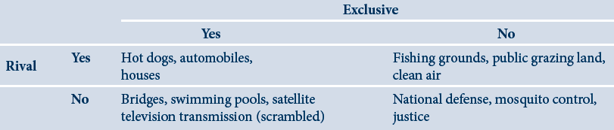
19.1 Examples showing the typology of public and private goods

Slide 40
Public Good
A good is a (pure) public good
  If, once produced
  No one can be excluded from benefiting from its availability
  And if the good is nonrival
    The marginal cost of an additional consumer is zero

Slide 41
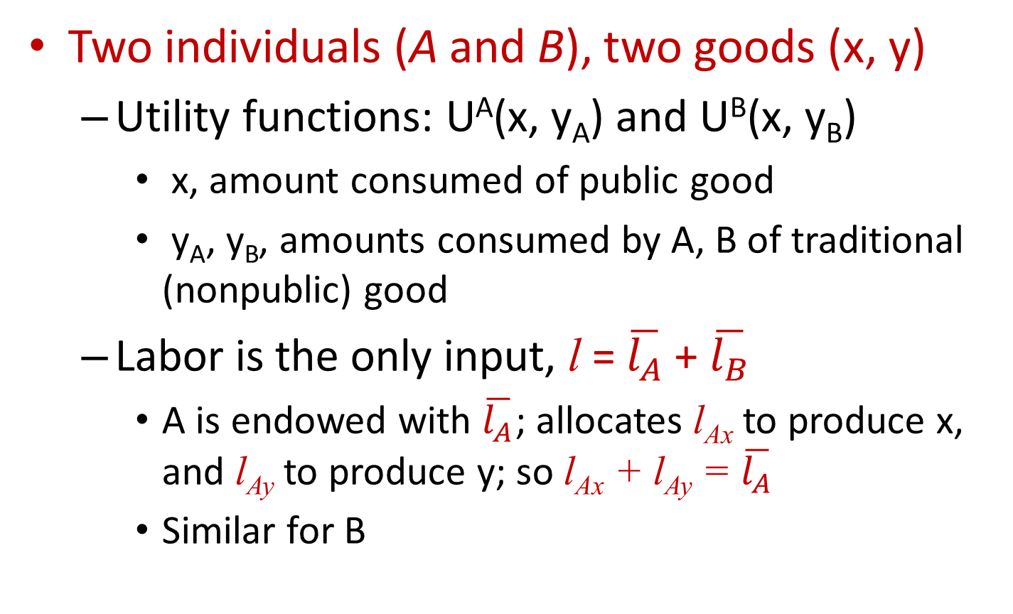
Public Goods and Resource Allocation
Two individuals (A and B), two goods (x, y)
  Utility functions: U^{A}(x, y_{A}) and U^{B}(x, y_{B})
    x, amount consumed of public good
    y_{A}, y_{B}, amounts consumed by A, B of traditional (nonpublic) good
  Labor is the only input, l = $\overline{l_{A}}$ + $\overline{l_{B}}$
    A is endowed with $\overline{l_{A}}$; allocates l_{Ax} to produce x, and l_{Ay} to produce y; so l_{Ax} + l_{Ay} = $\overline{l_{A}}$
    Similar for B

Slide 42
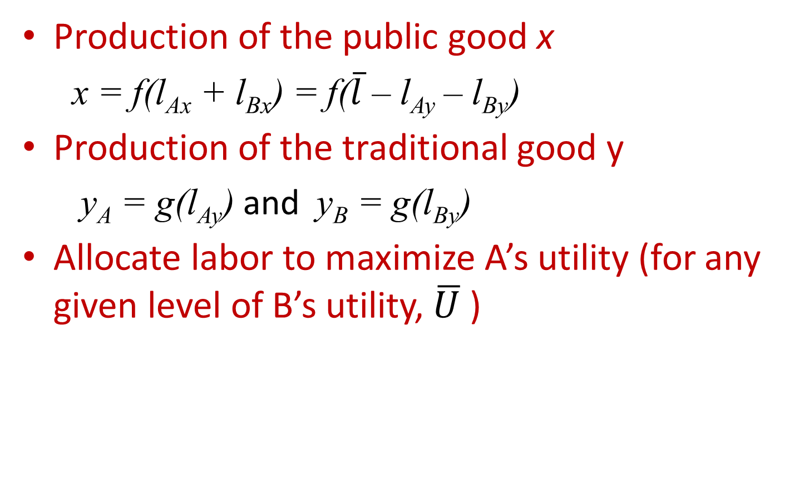
Public Goods and Resource Allocation
Production of the public good x
  x = f(l_{Ax} + l_{Bx}) = f($\overline{l}$ – l_{Ay} – l_{By})
Production of the traditional good y
  y_{A} = g(l_{Ay}) and y_{B} = g(l_{By})
Allocate labor to maximize A’s utility (for any given level of B’s utility, $\overline{U}$ )

Slide 43
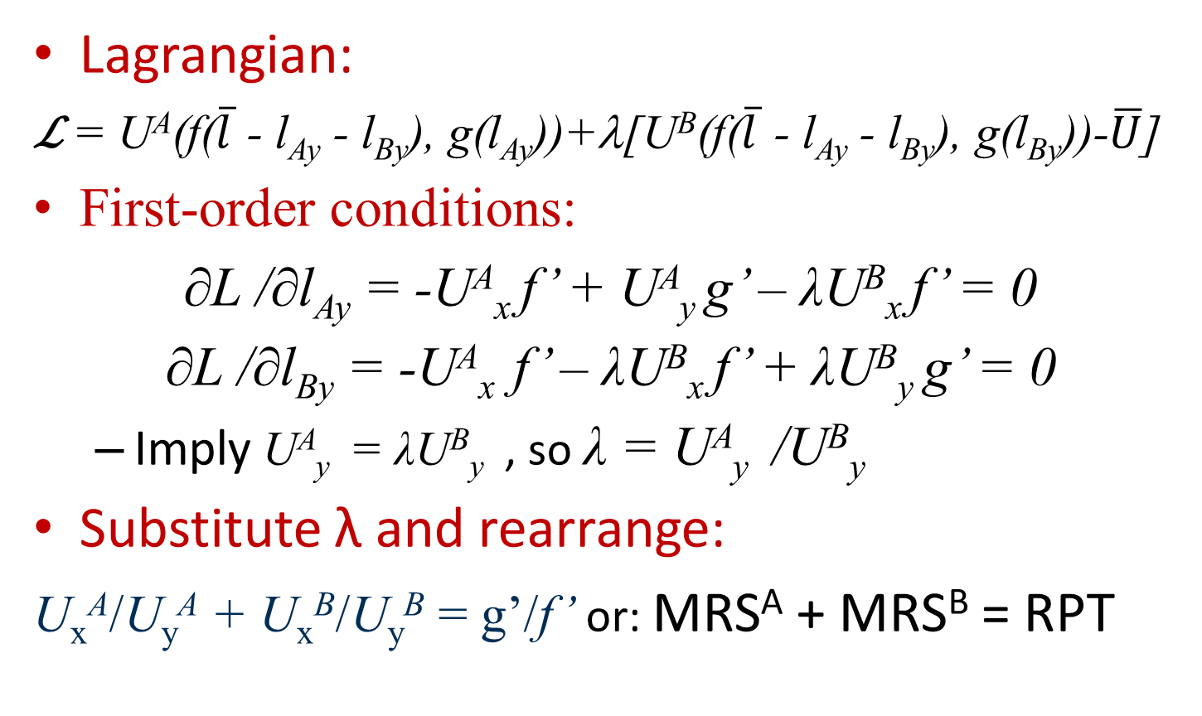
Public Goods and Resource Allocation
Lagrangian:
ℒ = U^{A}(f($\overline{l}$ - l_{Ay} - l_{By}), g(l_{Ay}))+λ[U^{B}(f($\overline{l}$ - l_{Ay} - l_{By}), g(l_{By}))-$\overline{U}$]
First-order conditions:
∂L /∂l_{Ay} = -U^{A}_{x} f’ + U^{A}_{y} g’ – λU^{B}_{x} f’ = 0
∂L /∂l_{By} = -U^{A}_{x} f’ – λU^{B}_{x} f’ + λU^{B}_{y} g’ = 0
  Imply U^{A}_{y} = λU^{B}_{y} , so λ = U^{A}_{y} /U^{B}_{y}
Substitute λ and rearrange:
U_{x}^{A}/U_{y}^{A} + U_{x}^{B}/U_{y}^{B} = g’/f’ or: MRS^{A} + MRS^{B} = RPT

Slide 44
Failure of a Competitive Market
Production of x and y in competitive markets
  Will fail to achieve this allocational goal
  Each individual will equate his MRS to p_{x}/p_{y}
  Profit maximization will lead to g’/f’ = p_{x}/p_{y}
  The price ratio p_{x}/p_{y} will be too low
    It would provide too little incentive to produce x

Slide 45
Failure of a Competitive Market
For public goods
  The value of producing one more unit
    Is the sum of each consumer’s valuation of that output
  Individual demand curves should be added vertically rather than horizontally
  The usual market demand curve will not reflect the full marginal valuation

Slide 46
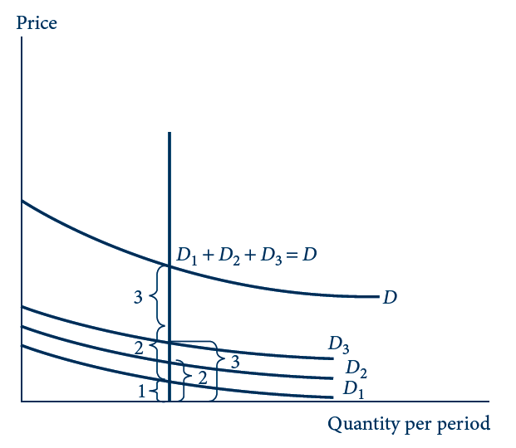
19.3 Derivation of the Demand for a Public Good
For a public good, the price individuals are willing to pay for one more unit (their “marginal valuations”) is equal to the sum of what each individual would pay. Hence, for public goods, the demand curve must be derived by a vertical summation rather than the horizontal summation used in the case of private goods.

Slide 47
Inefficiency of a Nash Equilibrium
The public good problem
  Competitive market fails to produce an efficient level of the public good
  Exists even with two agents behaving strategically (as long as they act independently )
  Tends to get worse as the number of agents increases
  Free-rider problem

Slide 48
19.3 The Roommates Dilemma
Two roommates, A and B, with identical preferences
  Derive utility from the cleanliness of their room and the knowledge gained from economics texts read
  Utility function for A: U^{A}(x,y_{A}) = x^{1/3}y_{A}^{1/3}
    y_{A} is the number of hours A spends reading (private good)
    x = x_{A} + x_{B} is the sum across roommates of the hours spent cleaning (public good)

Slide 49
19.3 The Roommates Dilemma
If the roommates make their consumptions decisions independently
  Nash equilibrium in which roommates play mutual best responses
  Roommate A maximizes utility (x_{A} + x_{B})^{1/3}y_{A}^{2/3}
    Subject to the (time) budget constraint 10 = x_{A} + y_{A}
  Lagrangian:
  L = (x_{A} + x_{B})^{1/3}y_{A}^{2/3} + λ(10 – x_{A} – x_{B})

Slide 50
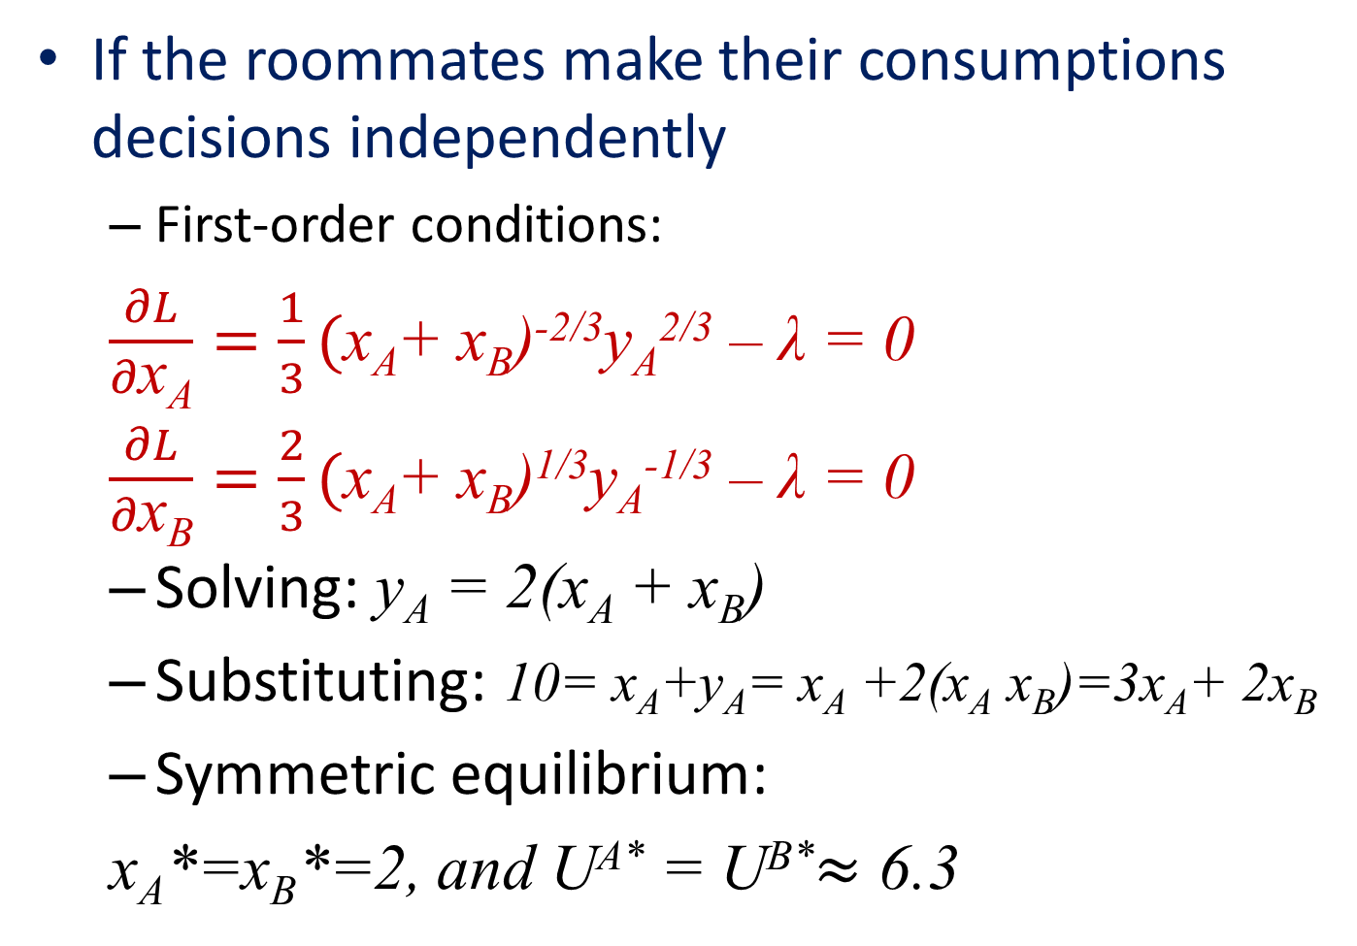
19.3 The Roommates Dilemma
If the roommates make their consumptions decisions independently
  First-order conditions:
  $\frac{∂L}{∂\text{x}\text{A}}=\frac{1}{3}(\text{x}\text{A}$+ x_{B})^{-2/3}y_{A}^{2/3} – λ = 0
  $\frac{∂L}{∂\text{x}\text{B}}=\frac{2}{3}(\text{x}\text{A}$+ x_{B})^{1/3}y_{A}^{-1/3} – λ = 0
  Solving: y_{A} = 2(x_{A} + x_{B})
  Substituting: 10= x_{A}+y_{A}= x_{A} +2(x_{A} x_{B})=3x_{A}+ 2x_{B}
  Symmetric equilibrium:
  x_{A}*=x_{B}*=2, and U^{A*} = U^{B*}$≈$ 6.3

Slide 51
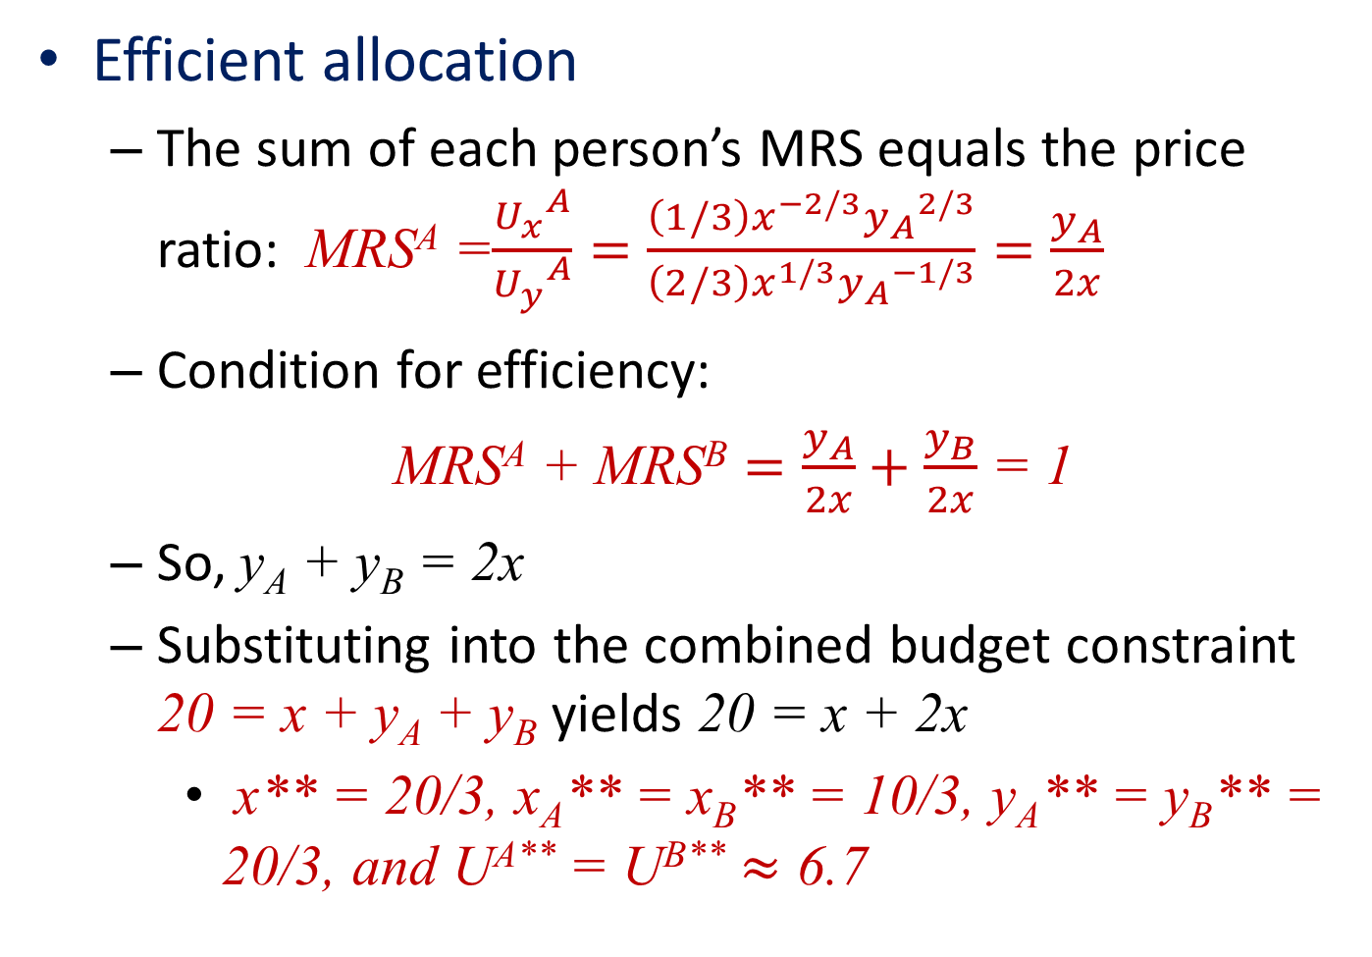
19.3 The Roommates Dilemma
Efficient allocation
  The sum of each person’s MRS equals the price ratio: MRS^{A} =$\frac{{U_{x}^{}}_{}^{A}}{{U_{y}^{}}_{}^{A}}=\frac{\left(1/3\right)x^{−2/3}{y_{A}}_{}^{2/3}}{\left(2/3\right)x^{1/3}{y_{A}}_{}^{−1/3}}=\frac{y_{A}}{2x}$
  Condition for efficiency:
  MRS^{A} + MRS^{B} $=\frac{y_{A}}{2x}+\frac{y_{B}}{2x}$ = 1
  So, y_{A} + y_{B} = 2x
  Substituting into the combined budget constraint 20 = x + y_{A} + y_{B} yields 20 = x + 2x
    x** = 20/3, x_{A}** = x_{B}** = 10/3, y_{A}** = y_{B}** = 20/3, and U^{A**} = U^{B**} $≈$ 6.7

Slide 52
19.3 The Roommates Dilemma
Comparison:
  The Nash equilibrium: too little cleaning, 2 hours each, compared to the 3.3 hours each in the efficient allocation
  Prisoners Dilemma: The Nash equilibrium (both fink) is Pareto dominated by another outcome (both remain silent)

Slide 53
19.3 The Roommates Dilemma
Generalization to n roommates
  Roommate A maximizes utility [x_{A} + (n-1)x_{B}]^{1/3}y_{A}^{2/3},
    Subject to budget constraint 10 = x_{A} + x_{B}
  Nash equilibrium: y_{A} = 2x
  Symmetric equilibrium with n roommates: x*=nx_{A}*
  Substitute y_{A}*=2x*=2nx_{A}* into the budget constraint: x_{A}* = 10/(2n + 1)
  As n increases, each roommate provides no cleaning (free-rider problem)
  The efficient amount of cleaning satisfies: n·MRS^{A}=n·y_{A} /2x = 1

Slide 54
19.3 The Roommates Dilemma
Generalization to n roommates
  The efficient amount of cleaning satisfies: n·MRS^{A}=n·y_{A} /2x = 1
  Symmetry: the sum of the MRS across roommates equals n·MRS^{A}
  So ny_{A}** = 2x**
  Substituting into the combined budget constraint 10n = x** + ny_{A}** = 3x**
  So: x** = 10n/3, x_{A}** = 10/3
  No surprise if a big group lives in messy conditions even though a small amount of effort from each would be enough to make the place sparkle

Slide 55
Lindahl Pricing of Public Goods
Swedish economist E. Lindahl
  Suggested that individuals might be willing to be taxed for public goods
    If they knew that others were being taxed
  Assumed that each individual
    Would be presented by the government with the proportion of a public good’s cost he was expected to pay
    And then reply (honestly) with the level of public good he would prefer

Slide 56
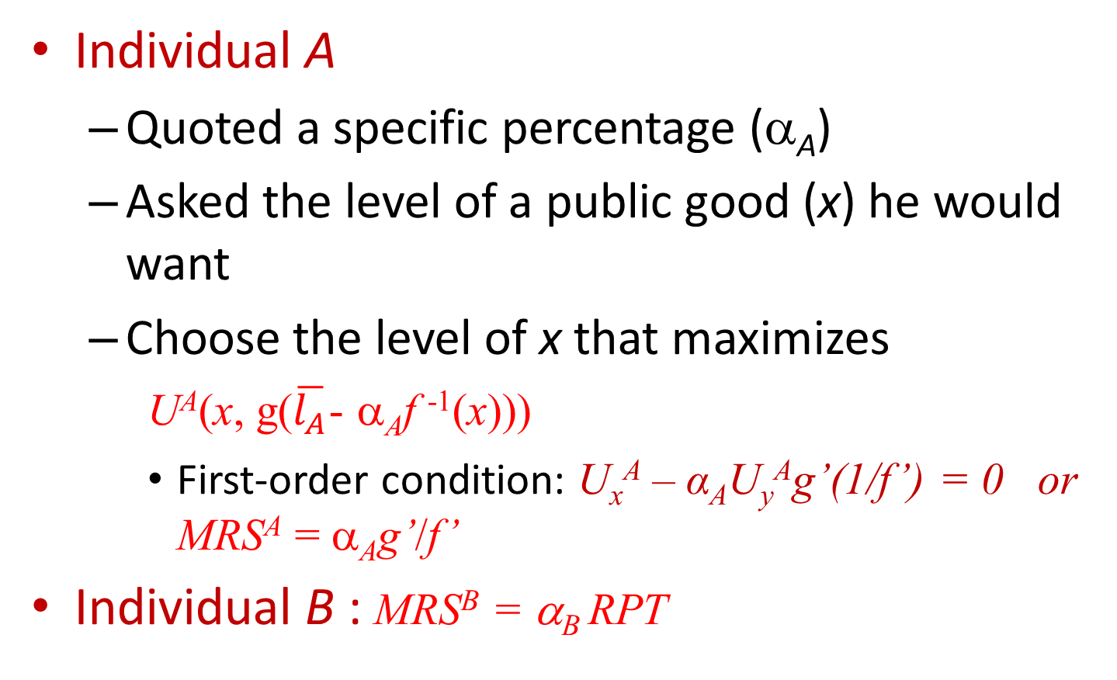
Lindahl Pricing of Public Goods
Individual A
  Quoted a specific percentage (α_{A})
  Asked the level of a public good (x) he would want
  Choose the level of x that maximizes
U^{A}(x, g($\overline{l_{A}}$- α_{A}f ⁻¹(x)))
    First-order condition: U_{x}^{A} – α_{A}U_{y}^{A}g’(1/f’) = 0 or MRS^{A} = α_{A}g’/f’
Individual B : MRS^{B} = α_{B} RPT

Slide 57
Lindahl Pricing of Public Goods
Equilibrium
  Occurs when α_{A}+α_{B} = 1
  The level of public goods expenditure favored by the two individuals
    Precisely generates enough tax contributions to pay for it
MRS^{A} + MRS^{B} = (α_{A} + α_{B})RPT = RPT

Slide 58
19.4 Lindahl Solution for the Roommates
‘‘The government’’
  Each roommate should contribute half the total cleaning effort
    Each would face an effective price per hour of total cleaning of a half hour of personal effort
Solution:
  x**=20/3, y_{A}**=y_{B}**=20/3
  Efficient solution
  Works if the government knows enough about the roommates’ preferences that it can set the payment shares in advance and stick to them

Slide 59
Shortcomings of the Lindahl Solution
The incentive to be a free rider is very strong
  Difficult to envision how the information necessary to compute equilibrium Lindahl shares might be obtained
    Individuals know their tax shares will be based on their reported demands for public goods
    Incentive to understate their true preferences

Slide 60
19.5 The Relationship between Environmental Externalities and Public Goods Production
A single representative person
  Utility function
  utility = U(x,y,l,g,c) = x^{0.5}y^{0.3}l^{0.2}g^{0.1}c^{0.2}
  g = public goods, innitially financed by a tax on labor; production requires capital and labor input: g = k^{0.5}l^{0.5}
  c = clean air
  There is an externality in the production of good y, so: c = 10 – 0.2y
Goal: allocate resources to maximize utility

Slide 61
19.5 The Relationship between Environmental Externalities and Public Goods Production
Base case: Optimal public goods production with no Pigovian tax
  Optimal level of public goods production requires g = 2.93
    And this is financed by a tax rate of 0.25 on labor
  Output of good y is 29.7
  Quantity of clean air is 4.06
  Utility is U = 19.34
    Highest utility that can be obtained in this situation without regulating the externality

Slide 62
19.5 The Relationship between Environmental Externalities and Public Goods Production
A Pigovian tax
  With a tax rate of 0.1
  Output of good y is reduced to y = 27.4; c = 4.52
  Revenue generated is used to expand public goods production to g = 3.77
  Utility is increased to U = 19.38
  Carefully specifying how the revenue generated by the Pigovian tax is used, a general equilibrium model permits a more complete statement of welfare effects

Slide 63
19.5 The Relationship between Environmental Externalities and Public Goods Production
The ‘‘double dividend’’ of environmental taxes
  Optimality can be achieved by reducing the labor tax to 0.20
  Public goods production to g = 3.31
  Utility expands even further to U = 19.43; c = 4.40
  These taxes reduce externalities relative to the untaxed situation
    But also the extra governmental revenue made available thereby may permit the reduction of other distorting taxes

Slide 64
Voting and Resource Allocation
Voting
  Used as a social decision process in many institutions
Direct voting
  Used in many cases from statewide referenda to smaller groups and clubs
In other cases
  Societies have found it more convenient to use a representative form of government

Slide 65
Majority Rule
Assume
  Decisions will be made by majority rule
Peculiarity of majority rule voting systems
  They may not arrive at an equilibrium but instead may cycle among alternative options
  The paradox of voting
  Condorcet’s paradox

Slide 66
The Paradox of Voting
Suppose there are three voters
  Smith, Jones, and Fudd
  Choosing among three policy options
  Assume that these policy options represent three levels of spending on a particular public good
    (A) low, (B) medium, and (C) high
  Condorcet’s paradox would arise even without this ordering

Slide 67
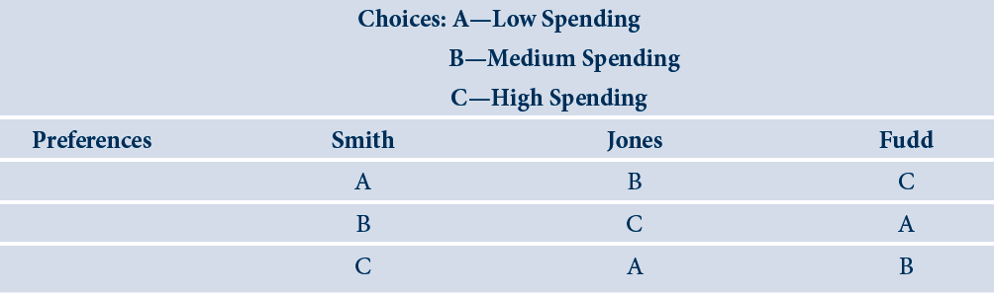
19.2 Preferences that produce the paradox of voting

Slide 68
The Paradox of Voting
Consider a vote between A and B
  A would win
In a vote between A and C
  C would win
In a vote between B and C
  B would win
No equilibrium will ever be reached

Slide 69
Single-Peaked Preferences
Equilibrium voting outcomes
  Always occur in cases where the issue being voted upon is one-dimensional and where voter preferences are “single-peaked”

Slide 70
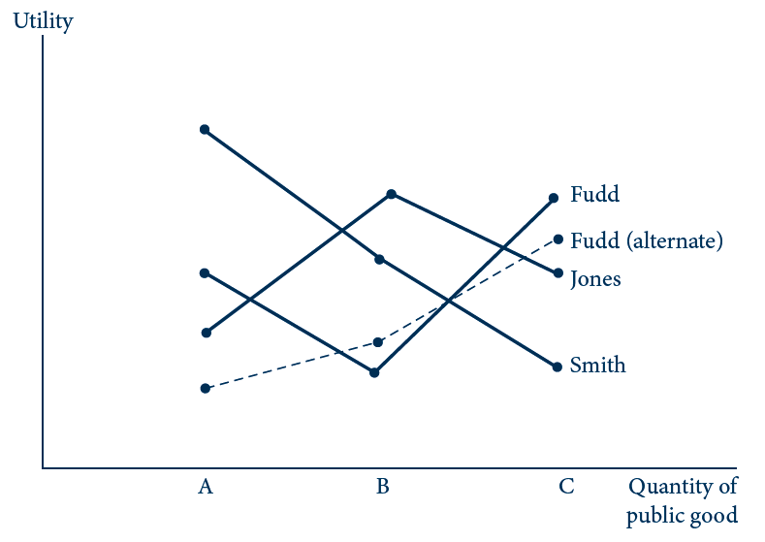
19.3 Single-Peaked Preferences and the Median Voter Theorem
This figure illustrates the preferences in Table 19.2. Smith’s and Jones’s preferences are single peaked, but Fudd’s have two local peaks and these yield the voting paradox. If Fudd’s preferences had instead been single peaked (the dashed line), then option B would have been chosen as the preferred choice of the median voter (Jones).

Slide 71
The Median Voter Theorem
With the altered preferences of Fudd
  B will be chosen because it is the preferred choice of the median voter (Jones)
  Jones’s preferences are between the preferences of Smith and the revised preferences of Fudd

Slide 72
The Median Voter
The median voter
  If choices are unidimensional and preferences are single-peaked
  Majority rule will result in the selection of the project that is most favored by the median voter
  That voter’s preferences will determine what public choices are made

Slide 73
A Simple Political Model
A community
  Large number of voters (n), each with income of y_{i}
  Utility of each voter depends on
    His consumption of a private good (c_{i})
    And of a public good (g) according to additive utility function
utility of person i = U_{i} = c_{i} + f(g)
    Where f_{g} > 0 and f_{gc} < 0

Slide 74
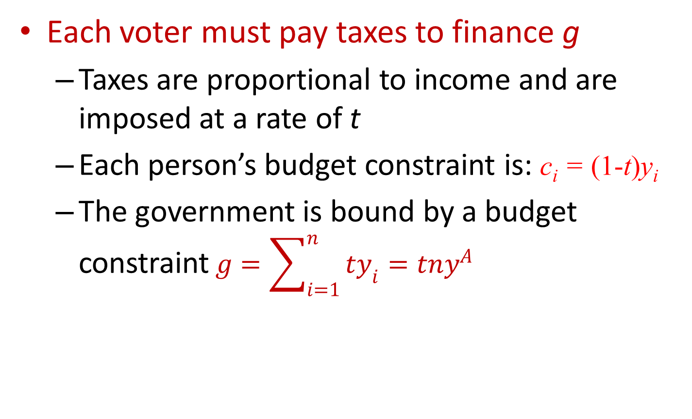
A Simple Political Model
Each voter must pay taxes to finance g
  Taxes are proportional to income and are imposed at a rate of t
  Each person’s budget constraint is: c_{i} = (1-t)y_{i}
  The government is bound by a budget constraint$g=\sum_{i=1}^{n}{ty_{i}}=tny^{A}$

Slide 75
A Simple Political Model
  Utility function of individual i:
U_{i}(g) = [y^{A} - (g/n)]y_{i} /y^{A} + f(g)
  Utility maximization occurs when
dU_{i} /dg = -y_{i} /(ny^{A}) + f_{g}(g) = 0
g = f_{g}⁻¹[y_{i} /(ny^{A})]
    Desired spending on g is inversely related to income

Slide 76
A Simple Political Model
The median voter equilibrium
  If g is determined through majority rule, its level will be that level favored by the median voter
  Voters’ preferences allign exactly with income
    g will be set at the level preferred by the voter with the median level of income (y^{m})
g* = f_{g}⁻¹[y^{m}/(ny^{A})] = f_{g}⁻¹[(1/n)(y^{m}/y^{A})]

Slide 77
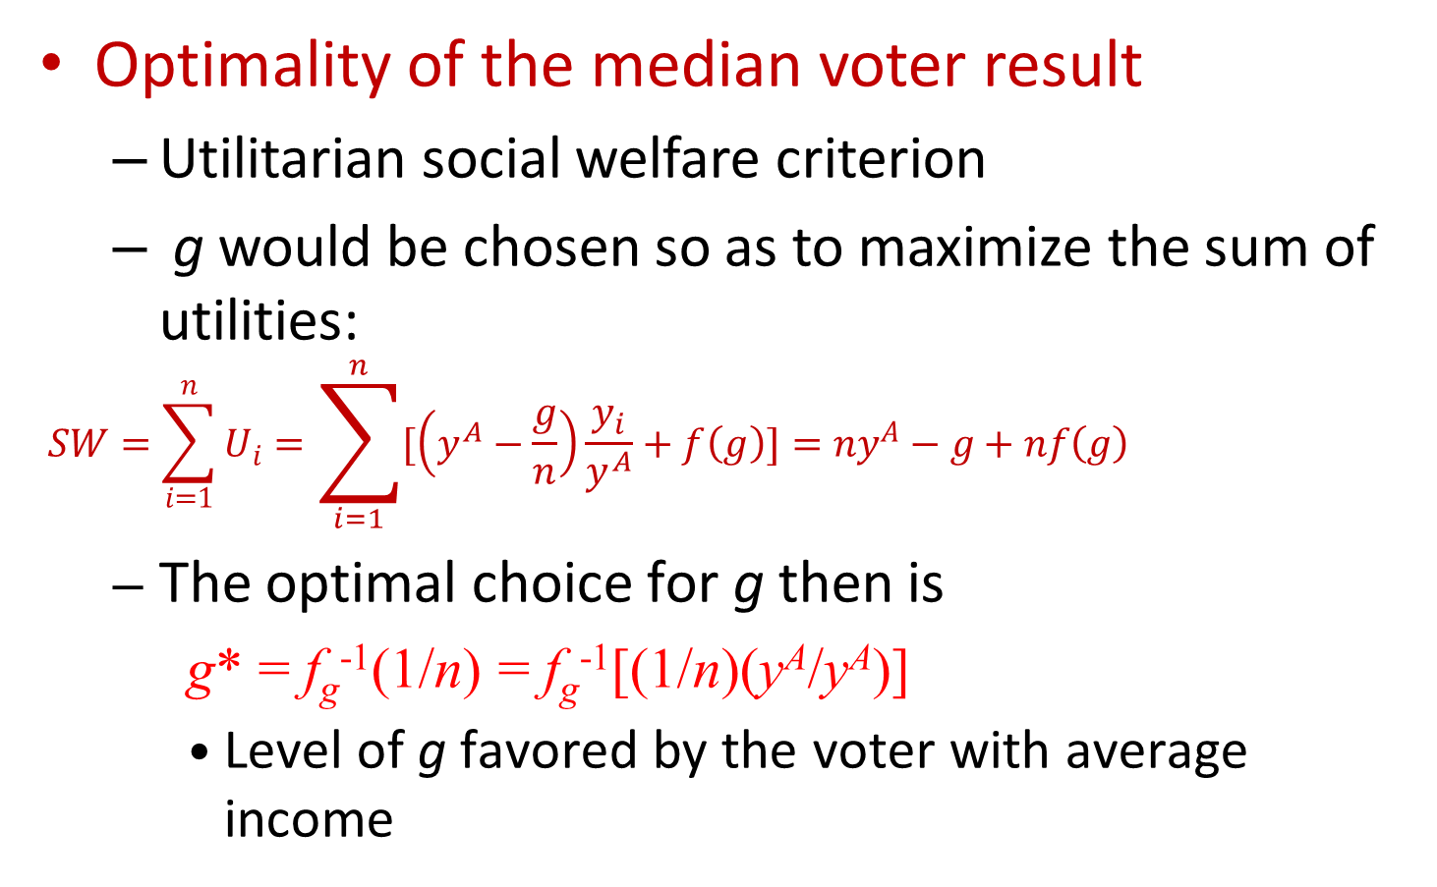
A Simple Political Model
Optimality of the median voter result
  Utilitarian social welfare criterion
  g would be chosen so as to maximize the sum of utilities:
$$SW=\sum_{i=1}^{n}{U_{i}}=\sum_{i=1}^{n}{[\left(y^{A}−\frac{g}{n}\right)\frac{y_{i}}{y^{A}}+f\left(g\right)]}=ny^{A}−g+nf\left(g\right)$$
  The optimal choice for g then is
    g* = f_{g}⁻¹(1/n) = f_{g}⁻¹[(1/n)(y^{A}/y^{A})]
    Level of g favored by the voter with average income

Slide 78
19.6 Voting for Redistributive Taxation
Voters
  Considering a lump-sum transfer to be paid to every person
    And financed through proportional taxation
  Per-person transfer, b
  Each individual’s utility: U_{i} = c_{i} + b
Government’s budget constraint
nb = tny^{A} or b = ty^{A}
For a voter whose income is greater than average
  Utility is maximized by choosing b = 0

Slide 79
19.6 Voting for Redistributive Taxation
Any voter with less than average income
  Will choose t = 1 and b = y^{A}
    Would fully equalize incomes
Each individual’s income - two components
  One responsive to tax rates [y_{i} (t)]
  One not responsive (n_{i})
Assume
  Average of n_{i} is zero, but its distribution is skewed right so n_{m} < 0

Slide 80
19.6 Voting for Redistributive Taxation
Utility: U_{i} = (1-t)[y_{i} (t) + n_{i}] + b
The individual’s first-order condition for a maximum in his choice of t and g:
dU_{i} /dt = -n_{i} + t(dy^{A}/dt) = 0
t_{i} = n_{i} /(dy^{A}/dt)
Under majority rule, the equilibrium condition will be
t* = n_{m} /(dy^{A}/dt)
  Positive rate of taxation

Slide 81
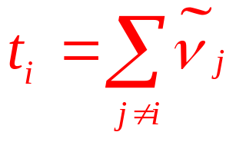
The Groves Mechanism
There are n individuals in a group
  Each has a private and unobservable valuation (ν_{i}) for a proposed taxation-expenditure project
The government
  If undertaken, the project will provide each person with a transfer given by
    Where $\tilde{ν}$_{j} is valuation reported by person j

Slide 82
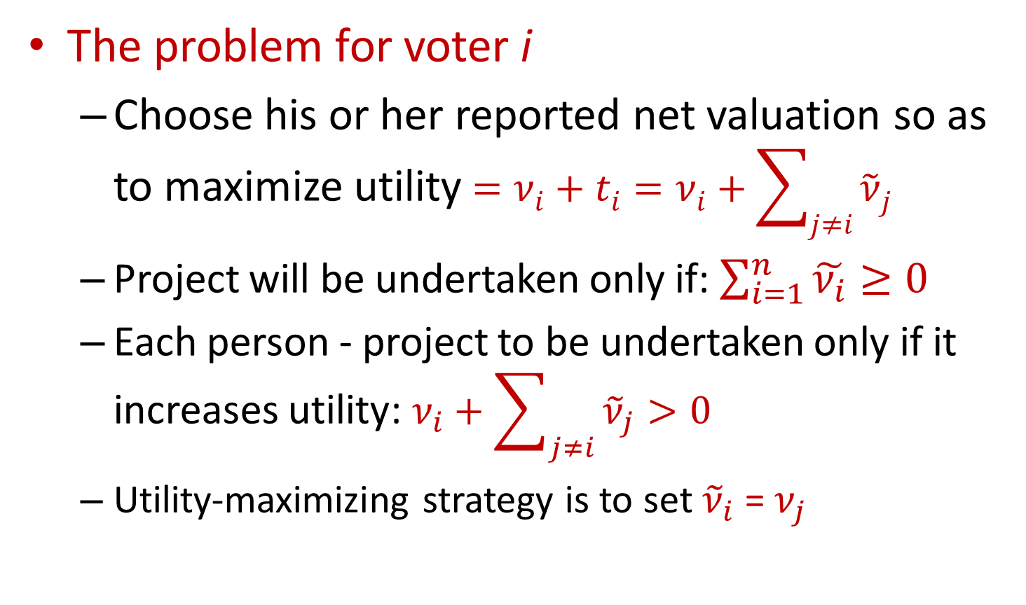
The Groves Mechanism
The problem for voter i
  Choose his or her reported net valuation so as to maximize utility$=ν_{i}+t_{i}=ν_{i}+\sum_{j≠i}{{\tilde{ν}}_{j}}$
  Project will be undertaken only if: $\sum_{i=1}^{n}{\tilde{ν_{i}}}≥0$
  Each person - project to be undertaken only if it increases utility: $ν_{i}+\sum_{j≠i}{{\tilde{ν}}_{j}}>0$
  Utility-maximizing strategy is to set ${\tilde{ν}}_{i}$ = $ν_{j}$

Slide 83
The Clarke Mechanism
The Clarke Mechanism
  Ask individuals about their net valuation of a public project
  Focuses on “pivotal voters”
    Those whose valuations can change the overall evaluation from positive to negative of vice versa

Slide 84
The Clarke Mechanism
The Clarke mechanism
  For the pivotal voters
    Incorporates a Pigouvian-like tax (or transfer) to encourage truth telling
  For all other voters
    There are no special transfers

Slide 85
Pollution Abatement
Two firms, A and B
  Their output levels, q_{A} and q_{B}, are fixed
  Emission by-products, e_{A} and e_{B}
  The physical amounts of these emissions can be abated using inputs z_{A} and z_{B}
    Which cost p per unit
Resulting levels of emissions are given by
f^{A}(q_{A},z_{A}) = e_{A} and f^{B}(q_{B},z_{B}) = e_{B}
    Where, for each firm, f₁ > 0 and f₂ < 0

Slide 86
Pollution Abatement
Optimal abatement
  Regulatory agency: e* = maximum allowable level of emissions
  e* would be achieved at minimal cost:
    Lagrangian: ℒ = pz_{A} + pz_{B} + λ(f^{A} + f^{B} – e*)
    First order conditions:
    p + λf₂^{A} =0 and p + λf₂^{B} =0
    We have: λ = -p/f₂^{A} = -p/f₂^{B}
      Cost-minimizing abatement is achieved when the marginal cost of abatement is the same for each firm

Slide 87
Pollution Abatement
Emission taxes
  The optimal solution λ = -p/f₂^{A} = -p/f₂^{B} can be achieved
    By imposing an emission tax (t) equal to λ on each firm
  Each firm seeks to minimize: pz_{i} + tf^{i}(q_{i},z_{i})
  Efficient solution: t = -p/f₂^{A} = -p/f₂^{B}

Slide 88
Pollution Abatement
Tradable permits
  Regulatory agency - set the number of permits (s*) equal to e*
    Allocate these permits among firms, s_{A}+s_{B}= s*
  Each firm - buy or sell any number of permits desired
    Ensure: emissions = number of permits
  Market price of permits, p_{s}
  Each firm’s problem: minimize pz_{i} + p_{s}(e_{i}-s_{i})
  Solution: p_{s} = t = λ

